Slide 1
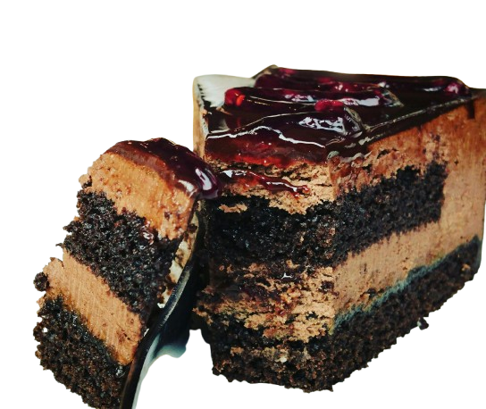
PROJECT TITLE
Mezbaani Cafe For Online Food Ordering
Presented by: Tejaswini Gosavi

Slide 2
CONTENT
Introduction
Service Description
Reasons
Objectives
Needs of Online Food Order & Table Booking
Functionalities
Features
Technology
Methodology Development Model
System Design Model
Admin Workflow Process & Flow Chart
Project Planning
Feature of System
Output Screen of Project
Limitations of The System
Conclusions
References

Slide 3

Introduction
The Online food ordering system typically consists of three main components: the customer-facing front-end, the cafe management back-end, and the payment gateway.
The front-end interface allows customers to view manus, select items, customize orders, and make payments.
The back-end management system enables restaurant owners to manage orders, track inventory, and manage customer data.
The payment gateway is a secure payment processing system that allows customers to pay for their order online using credit cards, debit card or other payment methods.
Online food ordering systems provide a range of benefits for both customers
and cafe owners. Customers can easily place orders from their homes or
workplaces without the hassle of phone calls or waiting in line. They can also
customize their orders and view real-time updates on the status of their orders.

Slide 4
Service Description
Mezbaani Cafe is a Django-based web application designed for cafes. The services provided include:
Menu Browsing: Customers can view a visually enriched menu categorized by food types, complete with item images, descriptions, and prices.
Cart and Checkout: Customers can add items to a virtual cart, review their selections, and place an order using multiple payment options such as Cash on Delivery or online payment modes.
Table Booking: A booking module allows users to reserve tables by selecting a date, time, and number of seats.
Order Management: Orders are tracked and processed through a backend admin dashboard, ensuring accurate and timely fulfilment.
Admin Panel: The admin interface provides features to manage categories, menu items, customer feedback, orders, and table reservations.

Slide 5
Reasons
An application that controls the entire business contributes to smooth management and makes it cost-efficient. Therefore, it is easier for you to grow your company faster, which may have taken longer with the normal way of investing time and making more expenditure. It can also ensure excellent customer services that helps to make the company more profitable leading to more purchases and loyal customers.
The key motivations for developing Mezbaani Cafe include:
Minimizing manual errors in order and table management.
Reducing customer wait time and improving satisfaction.
Providing transparency in menu selection and pricing.
Empowering business owners with admin-level insights.

Slide 6
Objectives
To create a responsive online system for ordering and reservation.
To implement a secure, user-friendly portal for customers.
To simplify backend order and table management for cafe staff.
To provide real-time confirmation and recordkeeping for orders/ bookings.
Provide a convenient and user-friendly way for customers to order food online.
Streamline cafe operations by automating the ordering and payment process.
Increase sales and revenue by expanding the customer base and offering new sales channels.
Reduce errors and improve accuracy in order processing.
Gather customer data and feedback to improve service quality and marketing strategies.
Improving efficiency and reduce wait times for customers.
Implement loyalty programs to incentivize repeat orders and increase customer retention.
Stay competitive in the food industry by keeping up with changing customer preferences and market trends.

Slide 7
Needs of Online Food Order & Table Booking
Helping customers in placing meal orders whenever they want. Customers will be able to order their preferred foods at any time, but as we’ve already mentioned, this is only a limited option. As a result, café need to have a specific system in place that will allow them to serve a large number of customers while streamlining operations. One of the best platforms is ordering, which offers all of these services in addition to a host of cutting-edge features that have helped countless small and large enterprises themselves as market leaders.
Growing demand for online food services post-COVID-19.
Enhancing customer experience with digital solutions.
Avoiding overcrowding and miscommunication at cafes.
Increasing order accuracy and transparency.
Efficient order queue and resource management

Slide 8
Functionalities
Online food ordering system also manages payment information for order details, order confirmation details and food items online.
It keeps track of all the data regarding categories, Payments, Orders, etc.
Manage the category’s details.
User Signup/Login
Menu display with category filtering
Cart management
Order placement and tracking
Table booking interface
Admin management panel
Feedback collection
Manage the order’s information by combining all Confirm Order data.

Slide 9
Features
Based on products and components.
Django-based backend with SQLite.
CSRF protection and form validation.
Distinct admin and user roles.
Easily creating and altering issues.
User accounts are used to manage access and uphold security.
Straightforward status & resolutions.
Attachment & Additional Comments for more information.

Slide 10
Technology
Software Requirement
Frontend: HTML5, CSS3, JavaScript, Bootstrap 4
Backend: Python 3.x with Django Framework
Database: SQLite (default Django database)
Browser: Google Chrome, Mozilla Firefox
Editor/IDE: Visual Studio Code or PyCharm
Operating System: Windows 10/Linux
Hardware Requirement
Processor: Intel i3 or higher
RAM: Minimum 4 GB
Storage: At least 2 GB of free disk space
Internet: Required for deployment and updates
Display: Minimum 1280×720 resolution

Slide 11
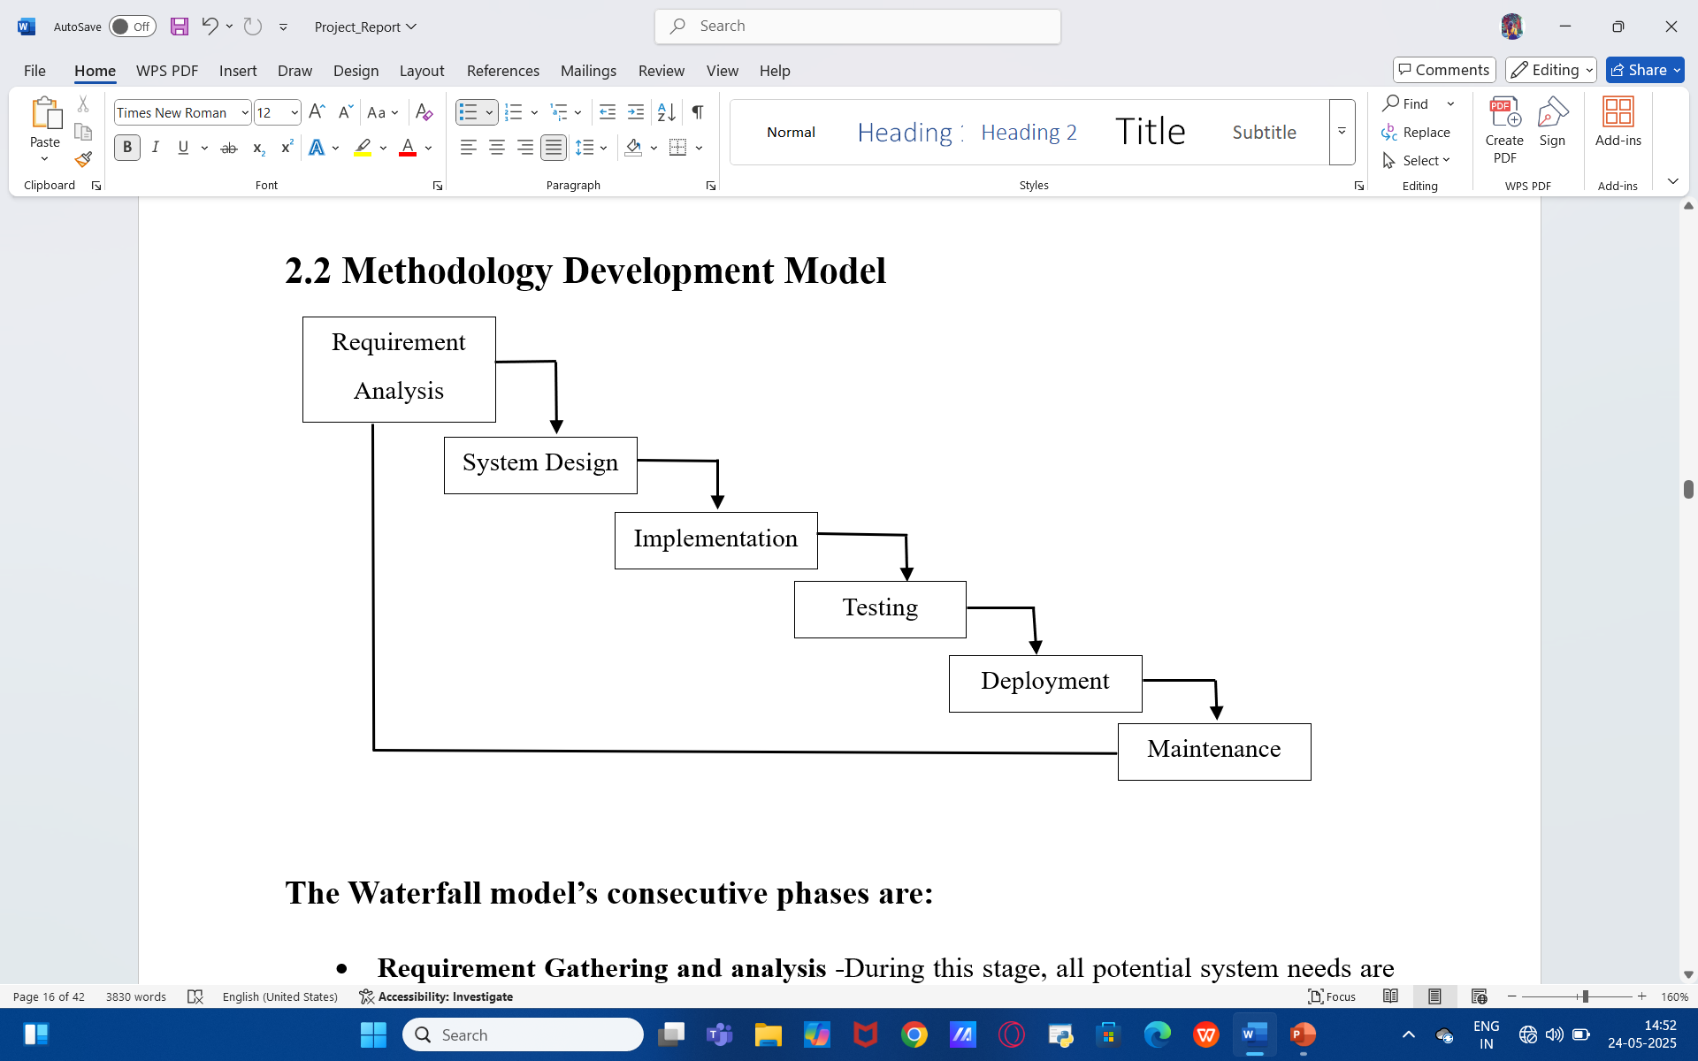
Methodology Development Model

Slide 12
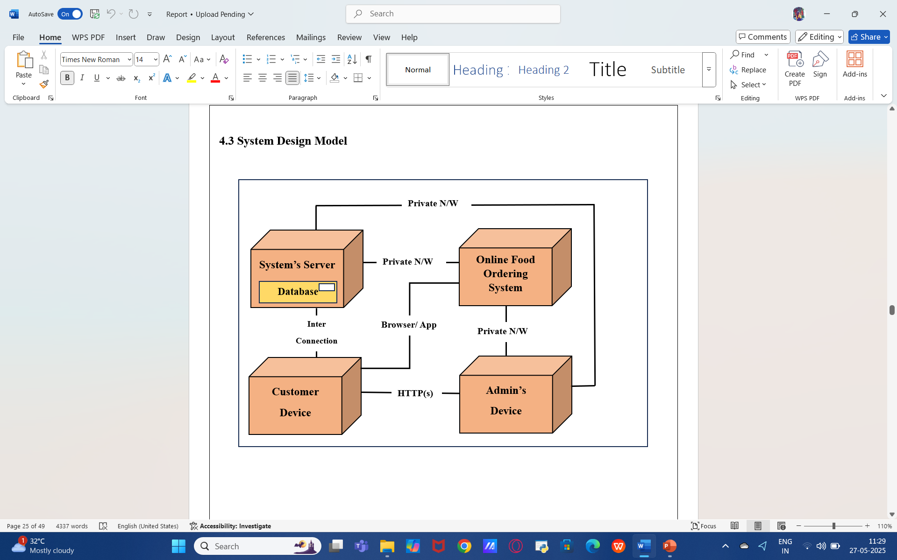
System Design Model

Slide 13
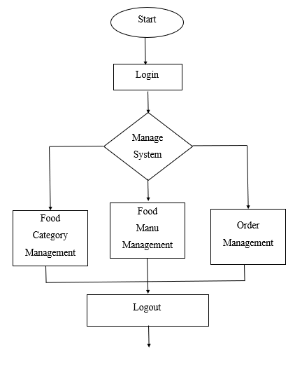
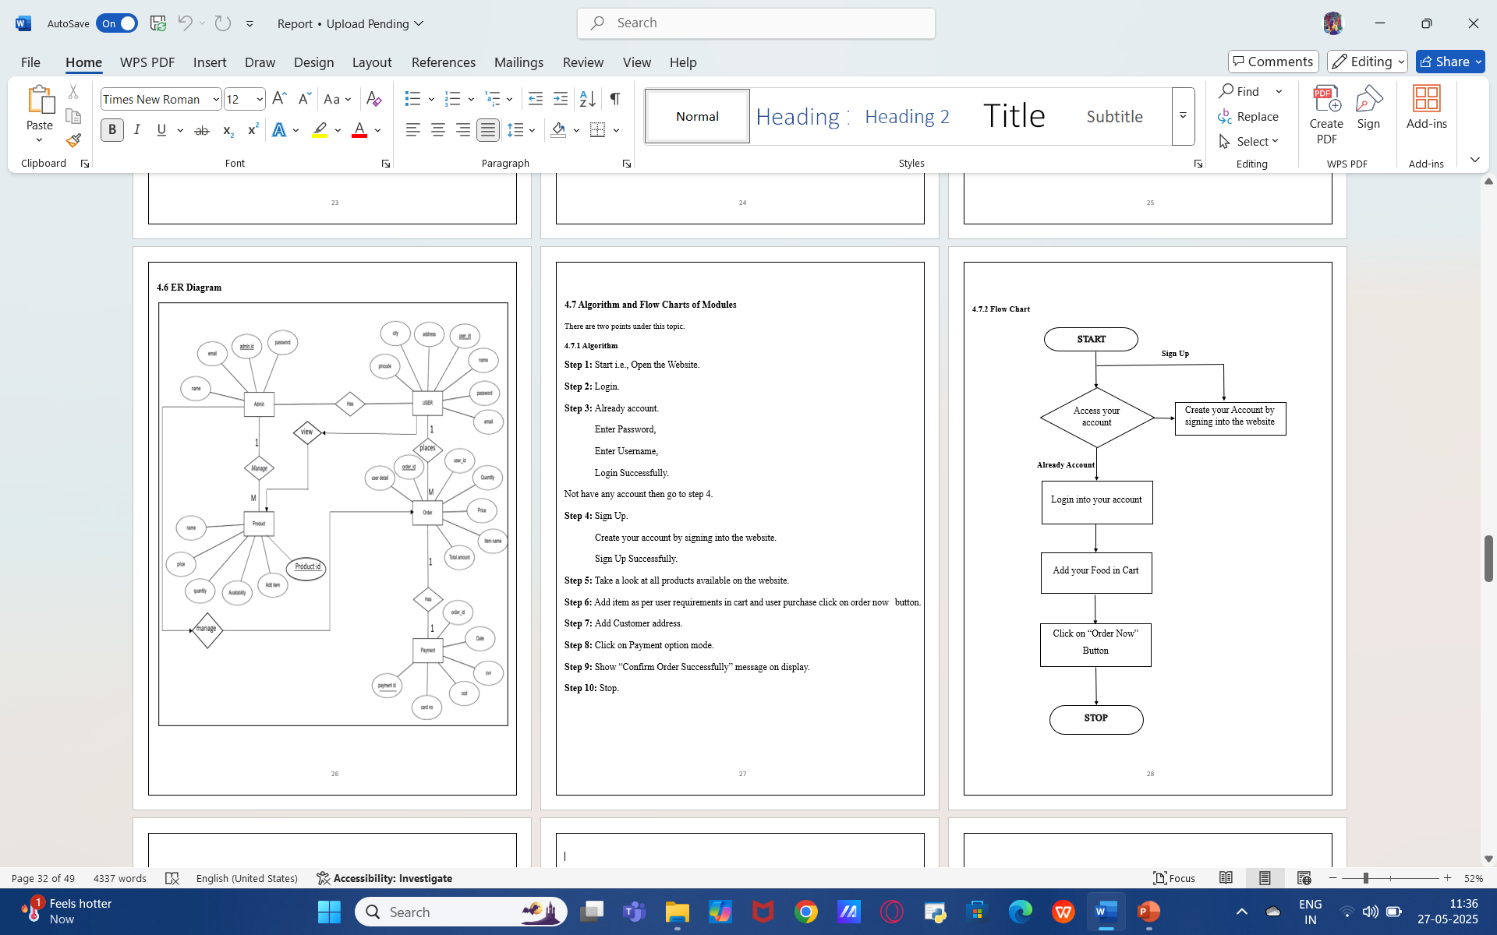
Admin Workflow Process
Flow Chart

Slide 14
Project Planning
A software design pattern called Model View Controller, or MVC as it is more formally known, is used to build online applications. There are three components to the Model View Controller pattern:
Model – The lowest level of the pattern, is in charge of maintaining the data.
View – This is in charge of showing the user all or part of the data.
Controller – The computer program that controls how the Model and View interact.
The project was executed in the following phases:
Phase 1: Requirement analysis and feature listing
Phase 2: Database design and model creation
Phase 3: Frontend and backend integration
Phase 4: Admin panel implementation
Phase 5: Testing and debugging
Phase 6: Documentation and final report preparation

Slide 15
Features of System
Fully functional online food ordering system
Interactive table booking module with confirmation
Secure login/signup for users and admins
Clean, categorized menu display with search functionality
Dynamic cart management system
Admin backend for item, order, and reservation management
Feedback section to gather user opinions
Mobile responsive design for better accessibility

Slide 16
Facing Problem During Development The Project
During the construction of the web application "Online Food Order," the developer ran into a few issues. Here are a few issues in brief:
During development, several challenges were encountered:
Session management: Handling cart data for guest and logged-in users required session-based tracking logic.
Form validation: Django’s form handling required custom validators for phone numbers and reservation times.
Image handling: Managing menu item images required proper media root configuration and testing on various browsers.
Admin panel access control: Ensuring that only superusers could access the admin dashboard was implemented using Django’s.

Slide 17
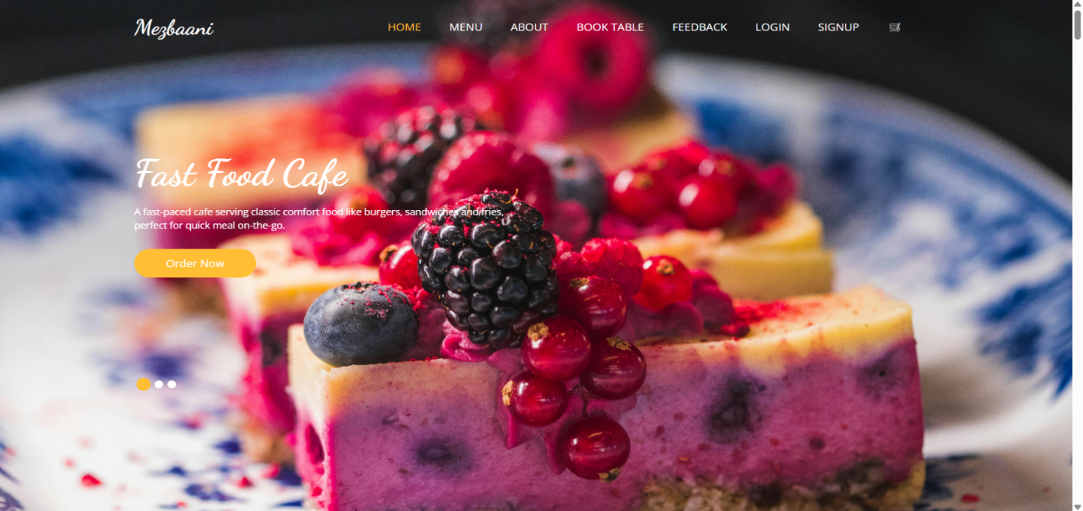
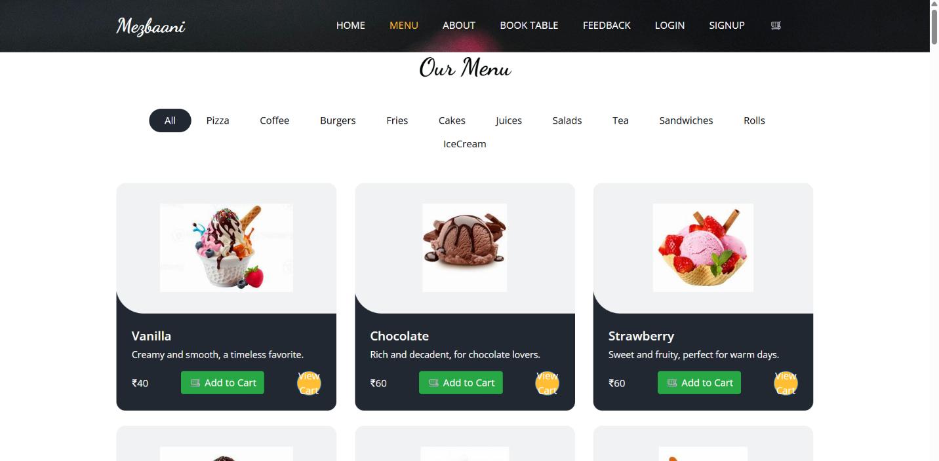
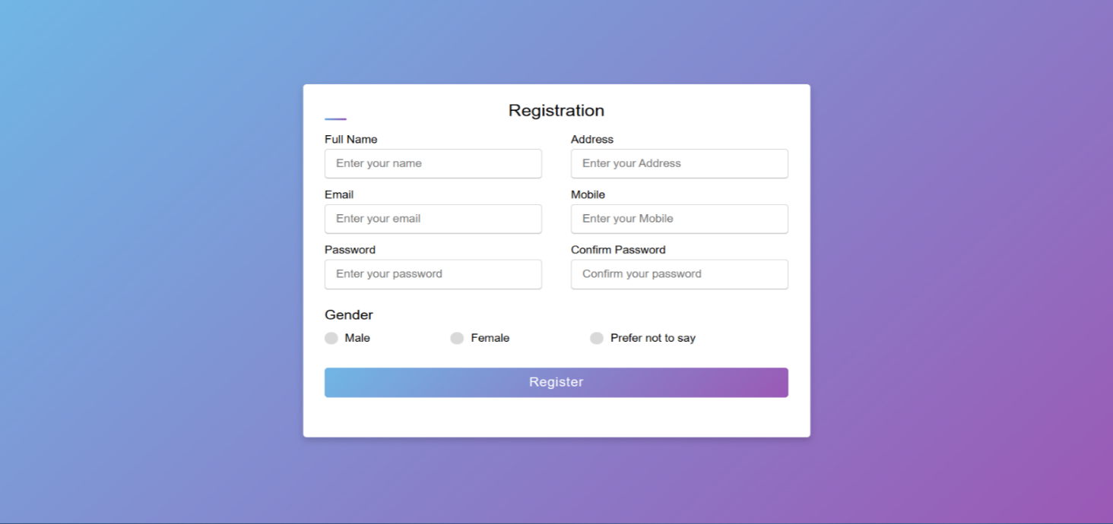
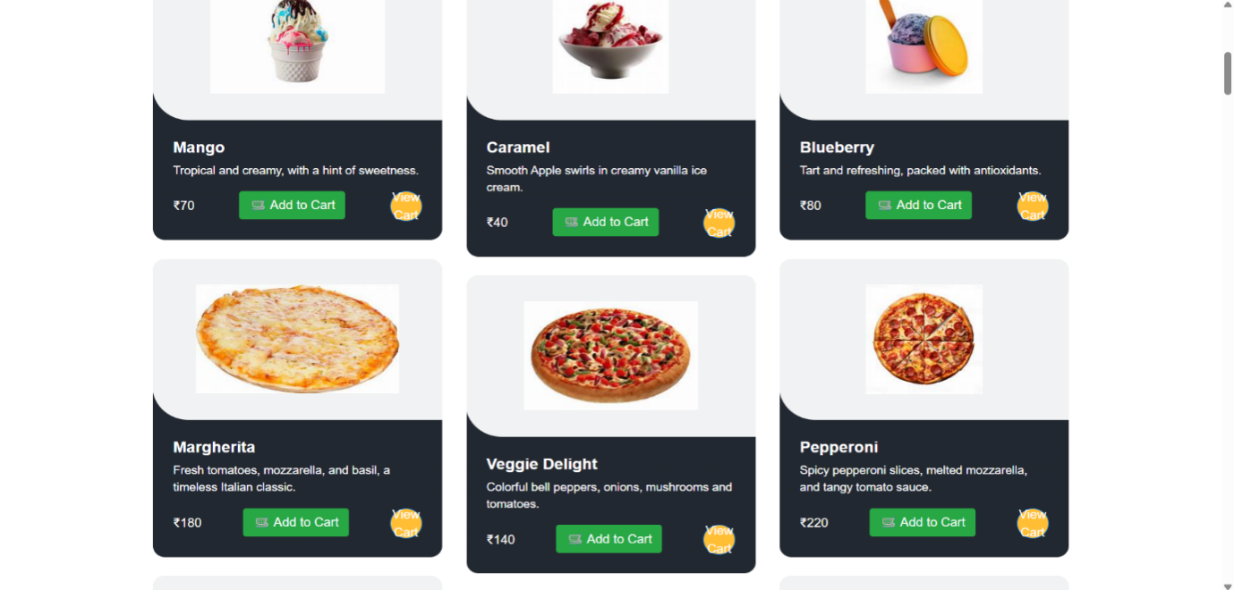

Output Screen of Project
Home Page
Menu Page
Registration Page

Slide 18
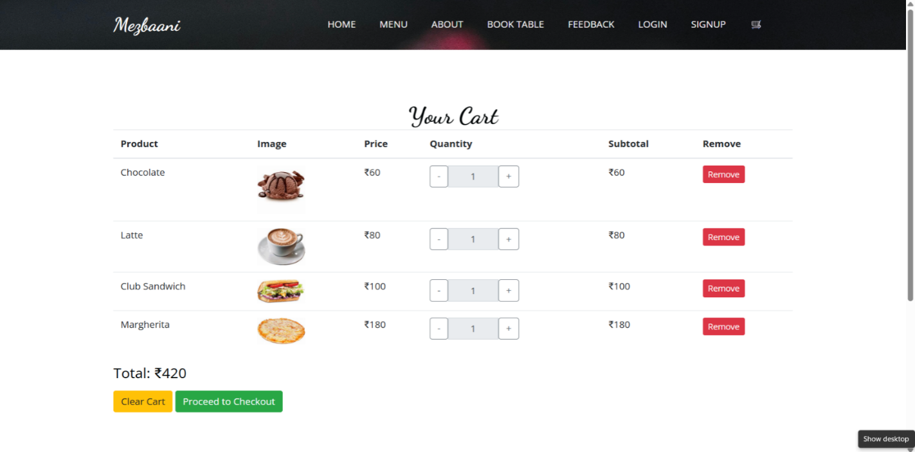
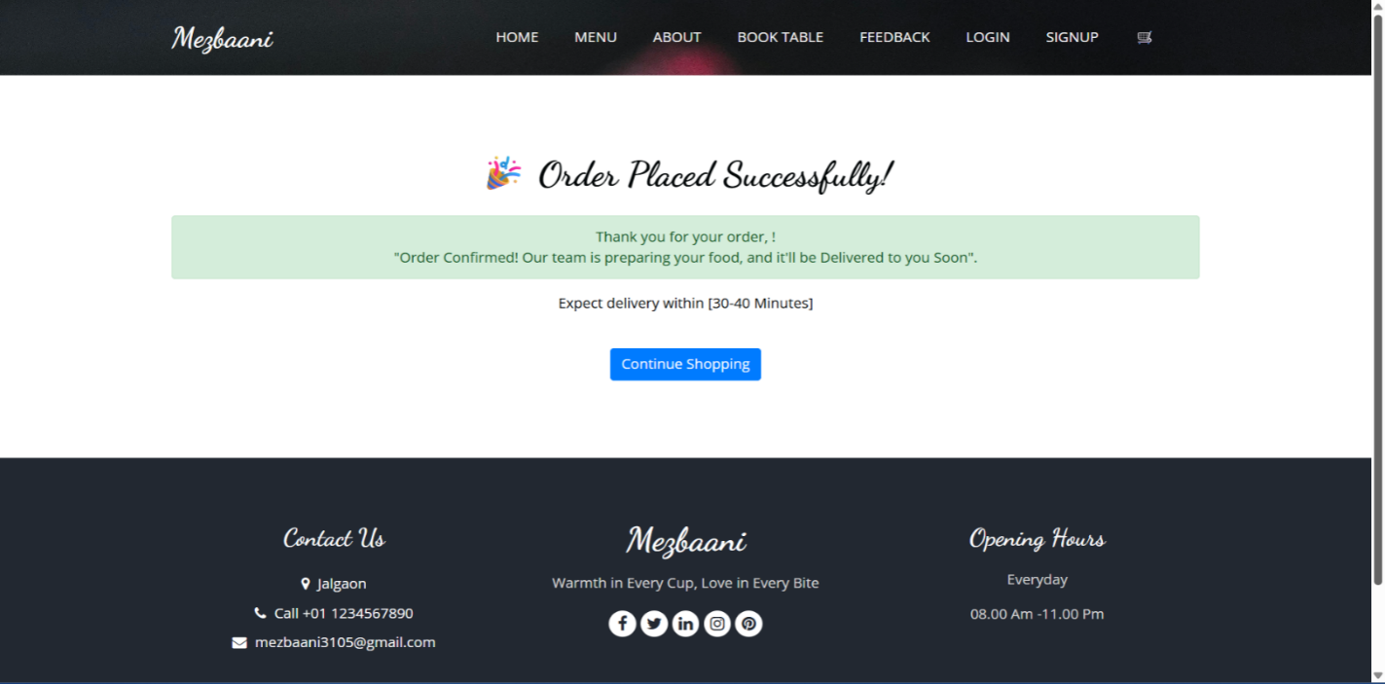
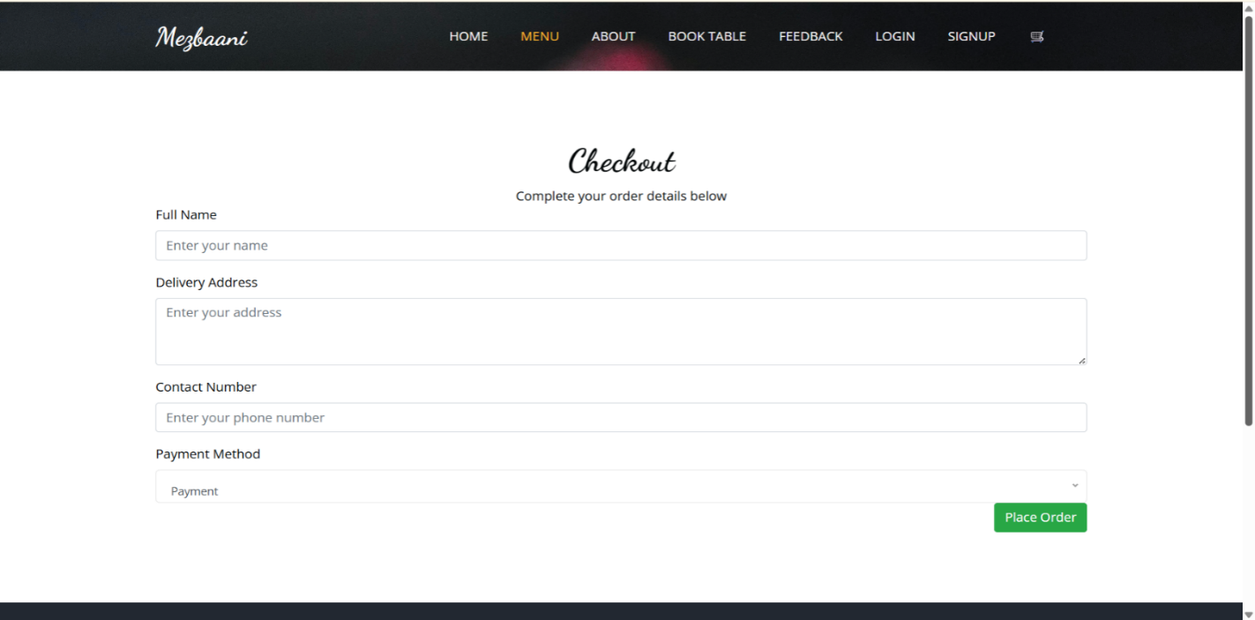
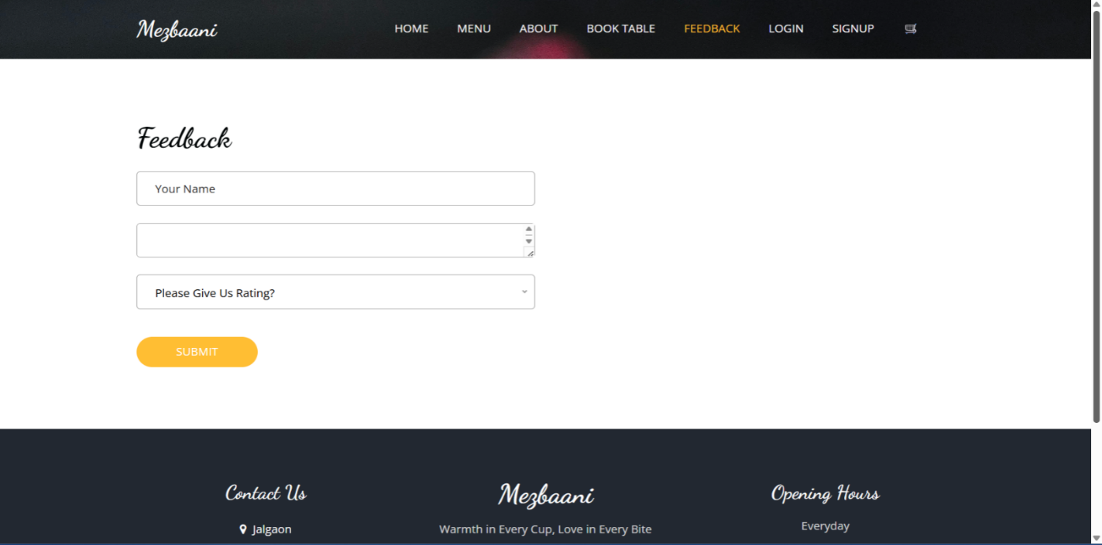
Cart Page
Order Confirmed Page
Checkout Page
Feedback Page

Slide 19
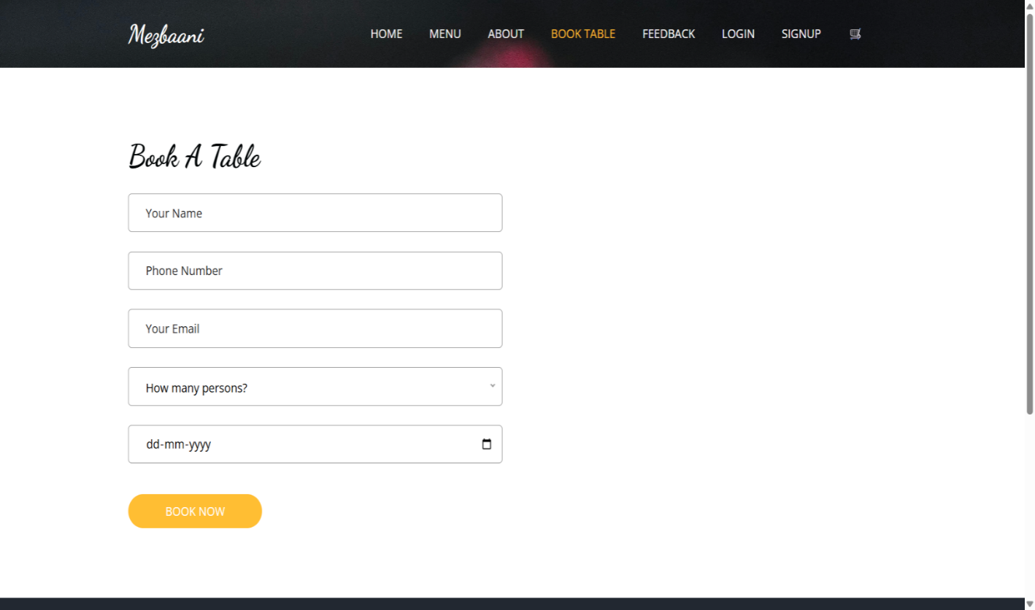
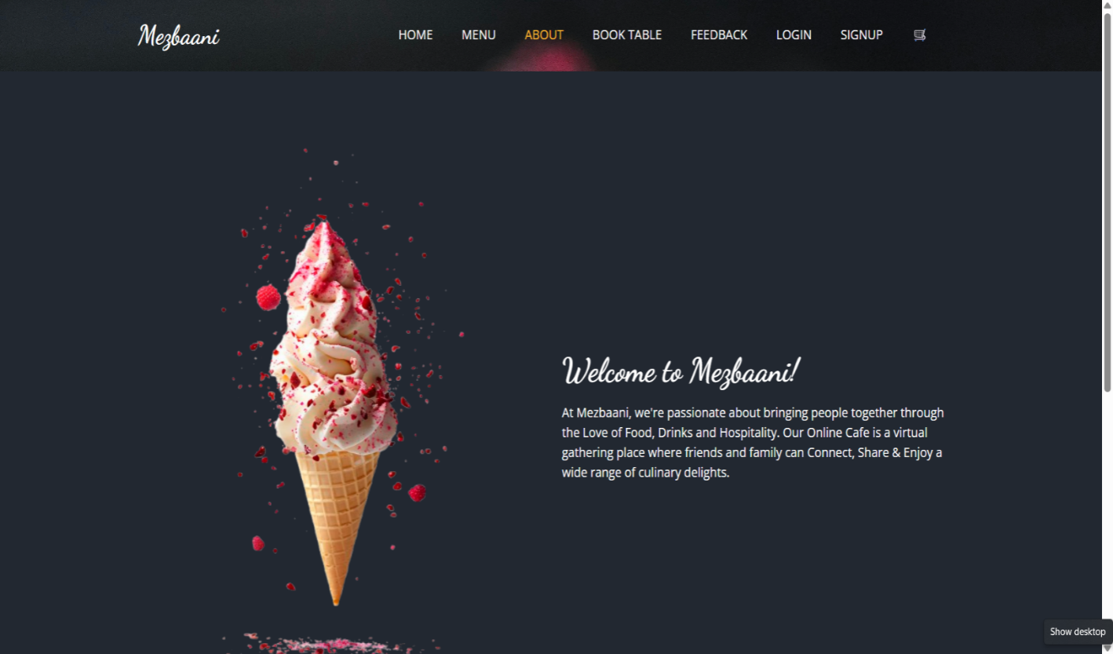
Booking Table Page
About Page

Slide 20
Limitations of The System
The system has certain other restrictions as well. There are only a few basic functions in the system’s shopping cart, and it can’t be extensively customized. Additionally, practically all of the functionality of the application, including validation, is handled by server-side programming.
The system currently supports only one branch of a cafe; multi-branch scalability is not implemented.
Email/SMS confirmation for orders or bookings is not integrated.
No support for real-time order tracking (e.g., delivery stages).
No advanced analytics dashboard for business insights.
System security is limited to Django’s default protections without custom encryptions or multi-factor authentication.

Slide 21
Conclusions
The Mezbaani project has effectively demonstrated the feasibility and benefits of integrating digital technology into the traditional cafe environment. Through features such as online food ordering, table booking, and admin management, the platform enhances customer convenience and streamlines backend operations.
The Django framework provided a secure and scalable foundation for development, while Bootstrap ensured a responsive and accessible frontend. During testing, the system showed reliable performance, user-friendly navigation, and smooth integration between different modules.
Although there are areas for future enhancement, the current system full fills the core objectives: reducing wait times, minimizing manual errors, and improving service efficiency. Overall, Mezbaani stands as a robust prototype for cafes looking to modernize their operations through web-based solutions.

Slide 22
References
[1] Django Documentation. https://docs.djangoproject.com
[2] Bootstrap Official Website. https://getbootstrap.com
[3] W3Schools – HTML, CSS, and JavaScript Tutorials. https://www.w3schools.com
[4] Stack Overflow – Developer Community. https://stackoverflow.com
[5] SQLite Documentation. https://www.sqlite.org/docs.html
[6] GitHub –Open-Source Django Projects. https://github.com
[7] Real Python – Django Web Framework Tutorials. https://realpython.com/tutorials/django/
[8] GeeksforGeeks – Python and Django Articles. https://www.geeksforgeeks.org
[9] ThemeWagon – UI Templates. https://themewagon.com
[10] Google Fonts & Icons – UI/UX Enhancements.

Slide 23
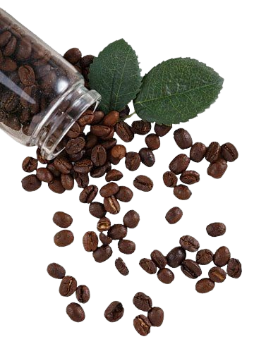
Thank You

